Slide 1
TRIPLE JEOPARDY: Protecting
At-Risk Refugee Survivors of Sexual and Gender-Based Violence
UNDERSTANDING SGBV AGAINST REFUGEE MEN AND BOYS

Slide 2
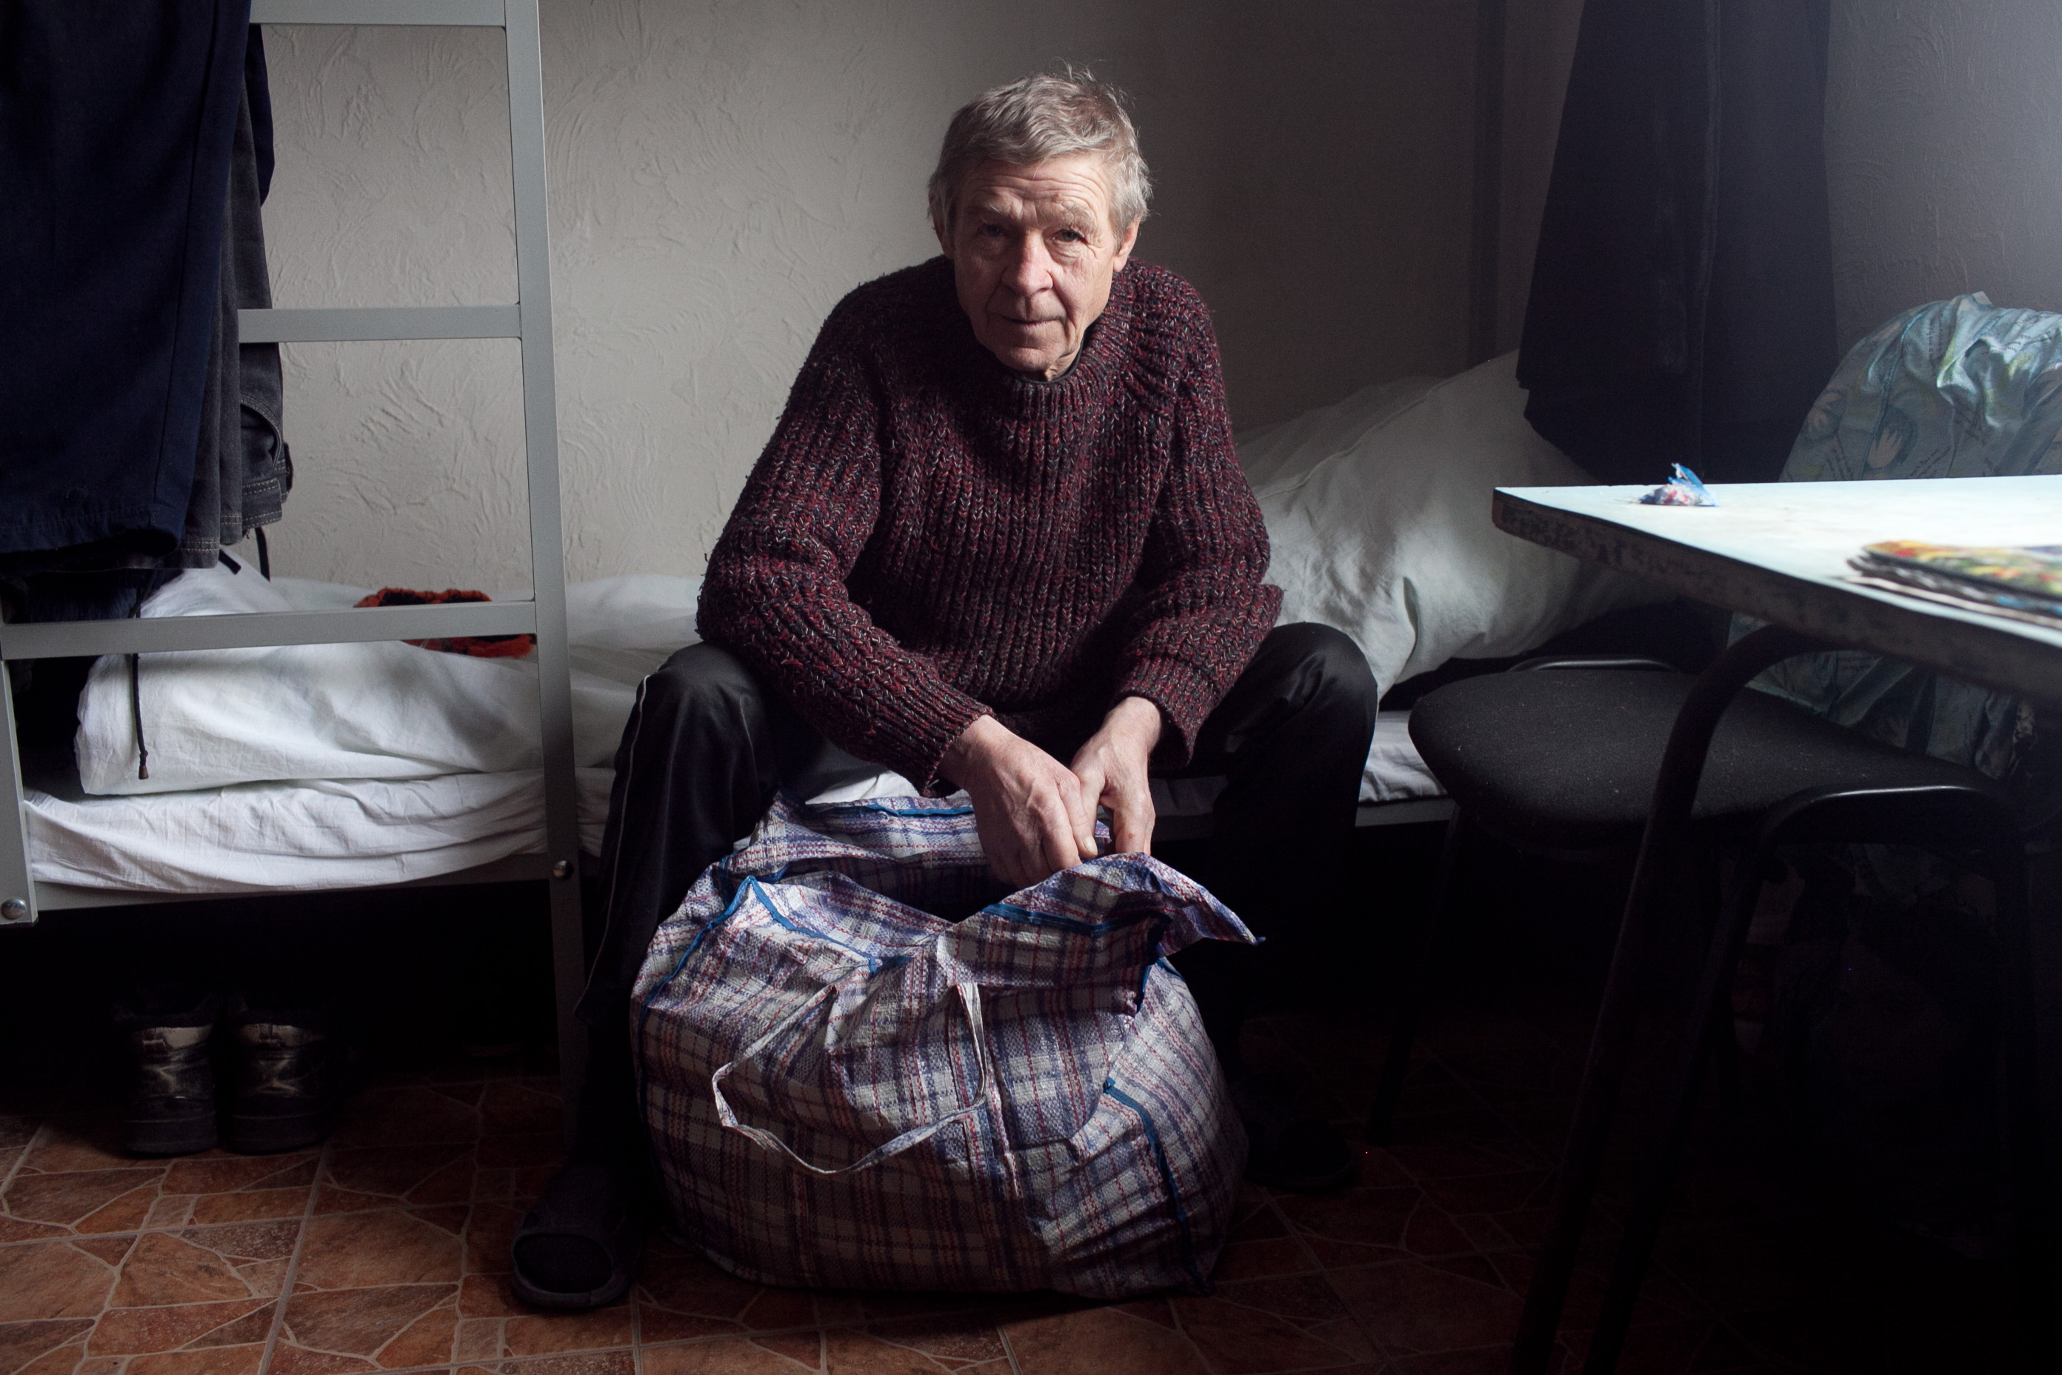
Objectives
By the end of the session, participants will understand
The dynamics and scope of SGBV against men and boys
Root causes and contributing factors that increase the vulnerability of refugee men and boys to SGBV
The forms and perpetrators of SGBV against refugee men and boys during migration

Slide 3
Quote from a Male Survivor
‘I was too embarrassed to tell [the police]. The police might have thought that I was gay and I am not, and what would they say? You know, I am a man. How can I explain that some men held me down and raped me? How come I could not protect myself and I am a man!’
Male SGBV Survivor, Johannesburg, South Africa, 20 February 2014.

Slide 4
SGBV Against Men
Men and boys face many forms of SGBV consisting of physical, emotional and sexual violence at a higher rate than is often presumed
The majority of perpetrators of SGBV against men are other men, but women can be perpetrators as well
SGBV against men is used as weapon of war, which means more cases of SGBV are likely to appear among refugees, soldiers and ex-combatants
Greater exposure to SGBV is reported among men with disabilities, prisoners or detainees
SGBV against males is hidden, underreported due to shame, stigma, fear of retaliation by perpetrators, lack of acknowledgment and response services
Women often struggle to process or effectively respond when they learn of SGBV against male family members

Slide 5
SGBV Against Boys
Limited resources and support pressures male refugees, especially boys, to engage in survival sex with other men to secure their basic needs
In countries where same-sex relations are criminalized, such relations may be accompanied by violence due to a fear of exposure
Many of the perpetrators of SGBV against refugee boys are known to them, including family members, neighbors, teachers or community leaders
Employers perpetrate SGBV against boys who work in local households outside refugee camps or traffic them to work in foreign cities

Slide 6
Types of SGBV against Men and Boys
Sexual Violence
Rape and gang rape (including being forced to rape others)
Insertion of objects into body orifices
Genital torture/castration
Sexual humiliation
Forced nudity
Sexual slavery
Sexual trafficking
Gender-Based Violence
Killing of men and boys
Forced army or militia conscription
Forced marriage
Forced circumcision
Domestic violence – physical and emotional

Slide 7
Myth or Fact?
Explain if the following statements are myth or fact
Sexual abuse of men and boys is carried out by homosexual men
Males who were sexually abused by males will become gay
Men and boys can experience erections or ejaculation/orgasm during rape without their willing participation
Women can be perpetrators of sexual and gender-based violence against males

Slide 8
Stigma and Marginalization
Societal myths, gender-related stigma and misconceived assumptions about men and boys make it hard for them disclose SGBV and seek help
These misperceptions add to the lack of knowledge and lack of appropriate response and outreach to male survivors of SGBV
This affects service organizations and family members, including wives and mothers of male survivors
Survivors experience a sense of betrayal and lack of compassion

Slide 9
Scope of the Problem
Group Brainstorming
How many cases of SGBV against refugee men and boys have you come across during the course of your work in the last 12 months?
How many cases of SGBV against men have you encountered or heard about during your professional or private life?

Slide 10
Power and Vulnerability During Displacement
Power – ability, skill or capacity to make decisions and take action
When one has less power, fewer choices are available
Displacement
Phases

Slide 11
Root Causes
SGBV against men & boy refugees is caused by
The need by some men to dominate others
Its use as a weapon of war, to reduce resistance and destroy the enemy community’s social fabric
The multiple marginalization of some males (refugees, older people, youth, people with disabilities) causing a collapse in social protection and a search for economic survival

Slide 12
Contributing Factors
Factors that contribute to SGBV against men and boy refugees include
Violent conflict and instability in the country of origin or asylum
Entrenched xenophobia and discrimination
Ineffective legal systems and lack of protective laws on SGBV against men and boys
Lack of humanitarian assistance and attention to men and boys as survivors of SGBV
Challenges to gender roles during forced migration
Poverty and lack of employment
Criminalization of same-sex acts

Slide 13
Forced Displacement and SGBV Risks for Boys
Unaccompanied minors are often without social network support and may form dependent relations that are risky
Forced migration may change hierarchical roles within the family, leading boys to seek their own ways of adaptation in the new country of asylum or resettlement
Lack of social and financial support and adult protection may lead to engagement in survival sex or the risk of being trafficked

Slide 14
Four Case Studies
Group Activity
At which phase of the forced migration cycle did the person experience SGBV?
What kind of SGBV did he experience?
Who were the perpetrators?
What were the root causes and contributing factors that enabled the acts of SGBV?
Who assisted the survivors?

Slide 15
Summary
Like SGBV against women and girls, SGBV against men and boys targets a survivor’s gender
SGBV against men and boys leads to stigmatization and social exclusion that affects survivors, families and communities
SGBV against men and boys is common, although rarely reported due to fear of disclosure and lack of understanding
Power differentials between adults and children make boys vulnerable to SGBV
Male refugees experience SGBV in all phases of migration
Lack of family protection and poverty make refugee boys vulnerable to abuse
Outreach to survivors, family members, community and service providers can increase identification of and support for refugee male survivors

