Slide 1
TRIPLE JEOPARDY: Protecting
At-Risk Refugee Survivors of Sexual and Gender-Based Violence
ACTION PLAN FOR INCLUSIVE SGBV PREVENTION AND RESPONSE –
OLDER REFUGEES

Slide 2
Objectives
By the end of the session, participants will be able to
Develop a community-based action plan
Addressing barriers older refugees face in SGBV prevention and response
Using a Twin-Track Approach
Inclusive of participants regardless of their sex, gender, age, ability or legal status

Slide 3
Definition of Inclusive SGBV Prevention
A collaborative effort by community and agency stakeholders to end SGBV
Involving leadership by older refugees
Who are supported by key community stakeholders

Slide 4
Core Principles: Inclusive SGBV Prevention
Collaborative co-creating
Twin-Track Approach to inclusion
Long-term coalition led by empowered older refugees with, supported by key community stakeholders
Amplification of the capacities of older refugees

Slide 5
Building the Capacity of Older Refugees
Assets
Skills
Capacities
Relationships

Slide 6
Review: Barriers Facing Older Refugees
Attitudinal
Physical
Communication
Structural

Slide 7
Barriers to SGBV Prevention & Response
Group Activity
In your community, what barriers prevent older people from accessing SGBV prevention and response services?

Slide 8
Barriers to SGBV Prevention & Response
Group Activity
Choose the most serious prevention and response barriers
Attitudinal
Physical
Communication
Structural
Notes:
-

Slide 9
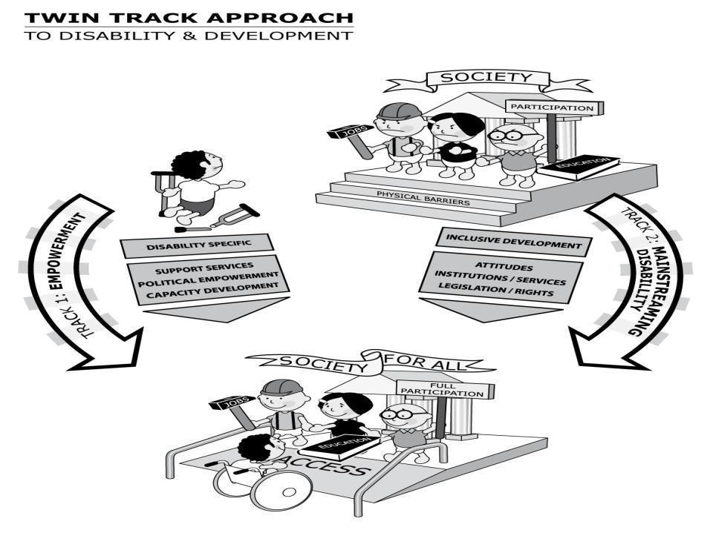
Twin-Track Approach
Source: CBM (2010) CBM and the Twin-Track Approach to Disability and Development

Slide 10
Track 1: Targeted Actions
Targeted actions empower older people, their families and caregivers (e.g., increasing their access to support services, healthcare, education, livelihood and social activities)
They may include political empowerment activities, such as mobilizing older refugees into representative groups

Slide 11
Track 2: Mainstreaming Actions
Modifying programs serving all people to be accessible to older people
Ensuring older people participate at all stages of programming
Design, implementation, evaluation
Working to remove attitudinal, communication, physical and structural barriers within SGBV programs and activities

Slide 12
Action Planning and Presentations
Group Activity
For each of the barriers, identify one targeted action and one mainstreaming action
You will have eight actions total
Present action plans to the group

Slide 13
Best Practices: Inclusive SGBV Prevention
Build capacity of older refugees, caregivers and others
Involve older people, caregivers in income-generating activities
Develop networks of community caregivers
Establish peer support for older people and caregivers

Slide 14
Best Practices: Inclusive SGBV Response
Sensitize stakeholders on rights of older people
Local and refugee community
NGOs, government agencies, professionals
Recruit older people
Professionals, mobilizers, volunteers
Offer self-help groups for older people
Partner with older people’s rights groups
Provide transportation, mobility aids

Slide 15
Summary
Inclusive SGBV prevention and response involves all stakeholders, with older refugees and caregivers taking the lead
A Twin-Track Approach empowers older refugees and mainstreams their inclusion into all existing programs
See handout on HIAS’ strategy for inclusive SGBV prevention in Chad and Uganda

