Slide 1
TRIPLE JEOPARDY: Protecting
At-Risk Refugee Survivors of Sexual and Gender-Based Violence
INCLUSIVE SGBV PREVENTION –
REFUGEES WITH DISABILITIES

Slide 2
Objectives
By the end of the session, participants will be able to
Identify and address barriers to refugees with disabilities participating in SGBV prevention
Introduce the Twin-Track Approach

Slide 3
Barriers to Participation
Attitudinal
Physical
Communication
Structural
Notes:
-

Slide 4
Attitudinal Barriers
Viewed as unable to fulfill gender roles
Intersectionality of disability, gender and refugee status (among other factors)
Lack of awareness about the daily reality of PWD
Taboos around sex and disability – often viewed as “asexual”
Fear and stigmatization
Assumptions about (in)capacity
“Over-protection” – keeping people with disabilities separate from others

Slide 5
Physical Barriers
Physical barriers in the environment
Stairs, lack of rails and ramps, uneven roads and paths, inaccessible toilet facilities
Lack of accessible and affordable transportation
Lack of outreach by community members or service providers to refugees with disabilities

Slide 6
Communication Barriers
Using only one format to communicate information and messages
Lack of awareness about respectful language
Lack of training of key interlocutors on communication with people with disabilities
Minimal spaces and few opportunities for consultation and dialogue
Lack of translators for refugees with disabilities (including sign language)

Slide 7
Structural Barriers
Invisibility of people with disabilities = lack of data, lack of funding, lack of inclusive programming
Programs encourage dependence rather than empowerment or community-based SGBV prevention
Financial barriers prevent refugees with disabilities and caregivers from attending prevention programs

Slide 8
Exercise: Power Walk
Group Activity
Identify factors which increase and decrease this person’s risk of SGBV
What barriers do they face in accessing programs and/or opportunities that might reduce their risk of SGBV?

Slide 9
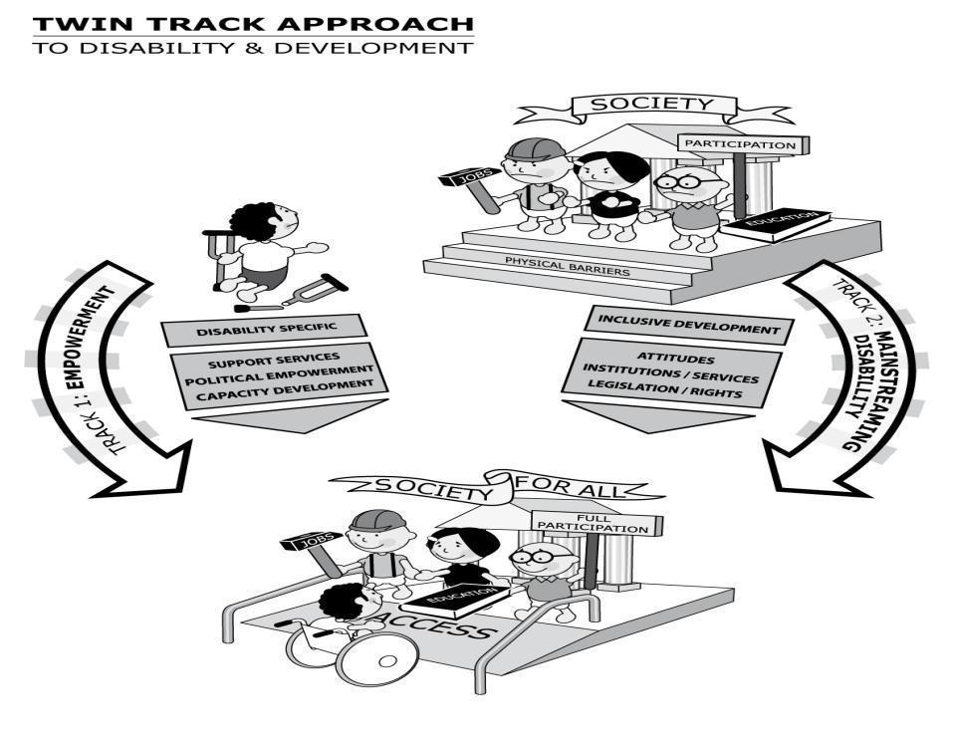
Twin-Track Approach
Source: CBM (2010) CBM and the Twin-Track Approach to Disability and Development

Slide 10
Track 1: Targeted Actions
Targeted actions enable and empower people with disabilities, their families and caregivers (e.g., increasing their access to support services, healthcare, education, livelihood and social activities)
They also include political empowerment activities, such as mobilizing refugees with disabilities into representative groups

Slide 11
Track 2: Mainstreaming Actions
Modifying SGBV programs serving all people to be accessible to people with disabilities
Ensuring people with disabilities participate at all stages of programming
Design, implementation, evaluation
Working to remove attitudinal, communication, physical and structural barriers within SGBV programs and activities

Slide 12
Exercise: Power Walk Continued…
Group Activity
Develop two strategies to address this barrier:
An empowerment strategy (Track 1)
A mainstreaming strategy (Track 2)

Slide 13
Summary
Attitudinal, physical, communication and structural barriers reduce access and participation of people with disabilities in a range of activities
We can use a Twin-Track Approach to address barriers, ensuring that people with disabilities have the same access as others to SGBV prevention activities

