Slide 1
TRIPLE JEOPARDY: Protecting
At-Risk Refugee Survivors of Sexual and Gender-Based Violence
IMPACT OF SGBV – SEXUAL MINORITY REFUGEES

Slide 2
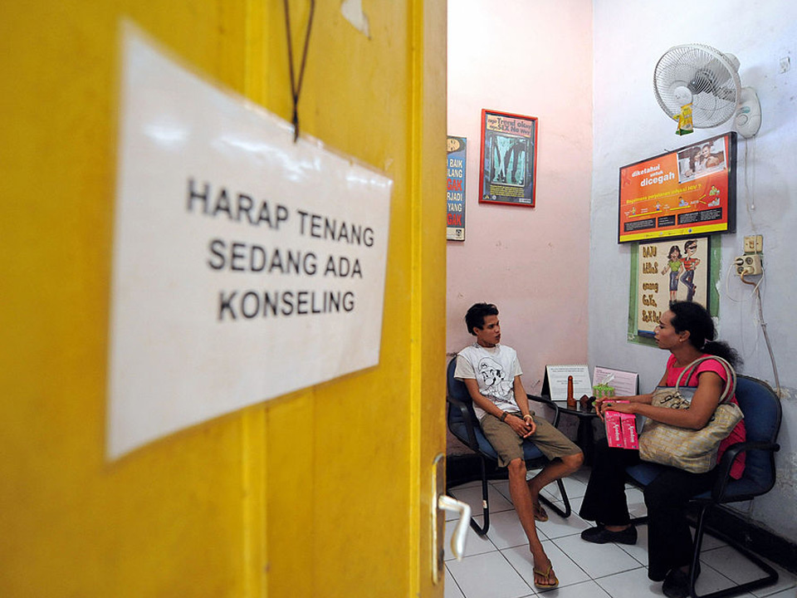
Objectives
By the end of the session, participants will be able to
Understand the impact of SGBV on survivors, with a focus on sexual minority refugee survivors
Recognize the specific needs of sexual minority refugee survivors

Slide 3
Consequences and Impact of SGBV
Group Brainstorming
What are the consequences of SGBV on
A survivor?
His or her family?
His or her community?

Slide 4
Physical Consequences of SGBV
Physical Consequences
Broken bones
Organ damage
Bleeding
Hemorrhoids
Functional impairments and permanent disabilities
Damage to the anus and loss of control over feces
Death
Reproductive Health Consequences
Pelvic inflammatory diseases
Sexually transmitted infections
Unwanted pregnancy
Miscarriage
Fistula and related reproductive health effects
Sexual physiognomic dysfunction
Infertility

Slide 5
Quote from a Sexual Minority Refugee Survivor
‘When I was very down and my brain was very… Really, I don’t know who to explain that. I was not even able to write a sentence. So I started going for counseling. I tried to see if I could use my brain again because I had finished university.’
Transgender Male Refugee, 10 January 2014.

Slide 6
Psychological Consequences of SGBV
Feelings of shame, humiliation, anger, fear, isolation, low self-esteem
Suicidal thoughts, suicide attempts, self-harm
Anxiety disorders and panic attacks
Post-traumatic stress disorder (PTSD) including nightmares, recurring distressing thoughts, depression and sleeplessness
Medically unexplained psychosomatic complaints
Feelings of insecurity, lack of a sense of self, connection to community

Slide 7
Psychosocial Consequences of SGBV
Social stigmatization, marginalization, hostility and rejection
Loss of social support networks
Withdrawal from domestic, social and economic activities
Isolation
Adopting conforming appearance as a coping mechanism and for protection
Becoming “invisible”

Slide 8
Quote from a Sexual Minority Refugee Survivor
‘You can’t just talk to anyone. You don’t know who was sent by the government or who is real. So it’s really hard to trust someone in a stable relationship. I don’t know who to trust and I don’t know who to live with for my own safety.’
Transgender Male Refugee, 24 January 2014.

Slide 9
Psychosexual Consequences of SGBV
Sexual dysfunction
Loss of sexual interest
Difficulties in intimate relations (as a result of mental or physical consequences)
Most of these difficulties are a result of psychological trauma to the survivor and persisting challenges of depression, low self-esteem and anxiety

Slide 10
Long-Term Impact of SGBV on the Survivor
Deterioration in physical and mental health due to marginalization and threat of further SGBV the country of asylum
“Intersectional discrimination”
Isolation from host community, refugees, local sexual minorities
Exclusion from employment; inability to work
Reduction or loss of education
Dependency/isolation
Risk of substance abuse
Risks associated with engaging in survival sex
Secondary victimization by response providers

Slide 11
Long-Term Impact of SGBV on the Family
Emotional, social and economic stress
Social stigmatization
Isolation
Tensions around gender roles and responsibilities
Reduced income
Increased expenses
Vulnerability to mental health-related problems
Notes:
-

Slide 12
Quote from a Sexual Minority Refugee Survivor
‘I know how to hide myself so that people are not aware about me. But, at home, my children are the ones suffering because the neighbors keep saying that their mother brings girlfriends home.’
Lesbian Refugee, 28 May 2014.

Slide 13
Case Study: Marcella
Marcella is a transgender woman from Colombia. She fled to Ecuador four years ago, after a gang members repeatedly raped her and vowed to “cleanse” the town where she lived of “degenerates.” With few opportunities to support herself, Marcella engages in sex work. She has been subject to physical and sexual violence from clients and other transgender sex workers. When she complains to the police, they send her away. She has become quite depressed. For a week she stayed home with her phone off. This caused her sister, whom Marcella usually calls twice a week, to worry for her safety.

Slide 14
Case Study: Marcella
Physical and Mental Health Consequences
Psychosocial Consequences
Economic Consequences
Consequences Affecting the Family

Slide 15
Summary
SGBV presents a myriad of physical, psychological, psychosocial and psychosexual consequences
SGBV not only impacts survivors, but also families and communities
Sexual minority refugees may face further exposure to SGBV in the country of asylum
They also face psychological and psychosocial consequences due to discrimination by the community and service providers
Sexual minority refugee survivors use self-isolation as coping mechanism for survival

